Slide 1
First Nation Education Updates: Education Jurisdiction, BCTEA, and Post-Secondary Education Presented by Tyrone McNeil, President, FNESC Our Gathering, Westin Bayshore, Vancouver January 22, 2020
FIRST NATIONS EDUCATION STEERING COMMITTEE

Slide 2
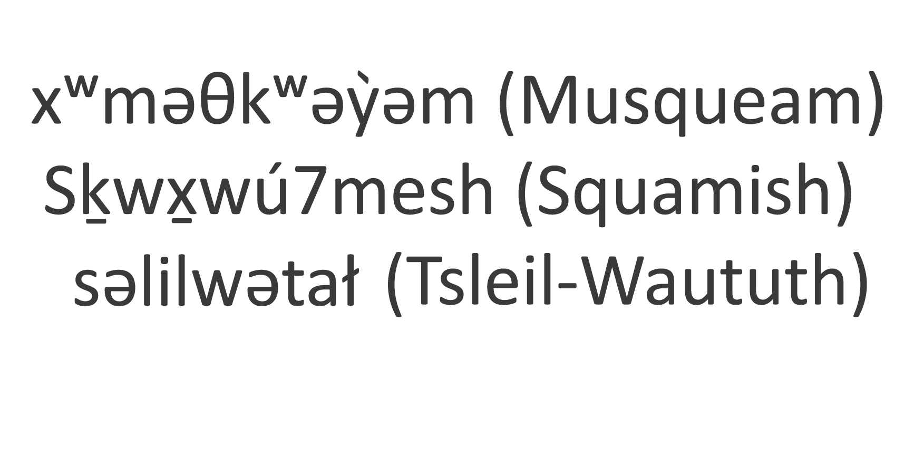
Recognition of the Territory
Notes:
Identify someone from the local FN to welcome to territory in advance
They will get a blanket as a gift

Slide 3
Presentation Overview
FNESC Overview
First Nations Education Jurisdiction
BC Tripartite Education Agreement (BCTEA)
Post-Secondary Education

Slide 4
About FNESC
FNESC works to support First Nations in their efforts to improve the success of all First Nations students and advance First Nations education in BC. FNESC currently has 129 Board members.
FNESC has a formal protocol with the First Nations Leadership Council (FNLC) that recognizes FNESC as the lead policy and advocacy body, as directed by First Nations governments, working to advance quality education, improved accountability, and improved education outcomes for all First Nation students in BC.
FNESC has subcommittees for Post-Secondary Education, Local Education Agreements, and First Nations Languages, as well as Personnel and Finance committees.
Notes:
The Board members represent 141 First Nations, when you take Tribal Councils into account.
Communities founded FNESC, as they felt it was important to come together and have a collective, unified voice. And if you look at the progress FN in BC have made in education compared to other parts of the country, you can see how effective that has been.

Slide 5
BC First Nations Education Jurisdiction

Slide 6
Current Picture
There are currently 13 Negotiating First Nations (NFNs) actively negotiating with Canada and BC to finalize updates to the education jurisdiction agreements. NFNs meet regularly to direct the education jurisdiction initiative.
There are also 56 Interested First Nations (IFNs) that have passed BCRs expressing an interest in the education jurisdiction initiative and have appointed a negotiator.
First Nations in BC have been advancing jurisdiction over education for more than two decades.

Slide 7
Background to Current Issues
Canada, BC and FNESC signed a package of education jurisdiction agreements in 2006, which were exempt from the application of Canada’s OSR Policy.
Federal and provincial supporting legislation was passed in 2006 and 2007.
The only critical outstanding issue at that time was funding to support the implementation of the agreements.
In 2010, negotiations came to a stand-still when Canada:
made funding offers
unilaterally imposed its Own Source Revenue (OSR) Policy to the agreements.
In 2012-13, First Nations and Canada conducted joint research on the impacts of the OSR policy.
Research showed the application of the OSR Policy would result in a claw-back of education funding averaging 30% (ranging from 10% to 95%).

Slide 8
Addressing the OSR Impediment
FNESC research also highlighted that the OSR Policy:
is not comparable to the funding model for public schools (which doesn’t look at school board revenues)
impacts First Nations’ ability to set their own priorities for spending
leads to inequitable financial impacts on First Nations.
In 2015, Canada reversed its policy and reinstated the OSR Policy exemption for sectoral self-government agreements (such as education), and negotiations resumed.
New draft template agreements were developed and sent to Canada for approval that included a permanent OSR exemption in July 2019.
NFNs were advised that PCO had confirmed the Minister’s ability to approve the replacement of the 2006 template agreements with the new jointly-developed versions on her own initiative (without the need for separate Cabinet approval).

Slide 9
Current Challenges
While awaiting for approval of the template agreements, plans for an initialing event were stopped in mid-August. CIRNA officials advised that support from other departments through a federal steering committee was now required before the updated jurisdiction agreements could be approved.
NFNs and FNESC have been very frustrated by inconsistent messaging regarding the federal approval process.
Various other options to advance the initiative were proposed by Canada and then also withdrawn over the weeks leading to the election.
To prevent further missteps, NFNs sent a letter to Deputy Minister Daniel Watson on September 18, 2019 proposing the development of a critical path to ensure that we can complete the final steps as soon as possible.
NFNs have still not received a response to their letter.
However, Canada has prepared and shared a draft critical path with NFNs.

Slide 10
Current Focus
Now that the federal election is over, NFNs are focused on:
Finalizing and obtaining approval for amendments to update the education jurisdiction agreements
Obtaining approval for funding to support the implementation of the initiative
Monitoring and providing input into the federal approval process
Preparing to initial their individual agreements
The initialing of agreements by individual First Nations will pave the way for NFNs to hold community ratification votes on their education jurisdiction agreement.

Slide 11
Current Challenges: Key Policy Issues
Federal officials have confirmed that there are three key policy issues currently under consideration by CIRNA and central agencies:
incorporating a permanent exemption from the application of the federal Own Source Revenue (OSR) policy in an Education Jurisdiction Agreement (EJA) that is not time-limited;
using an indeterminate (not time-limited) funding agreement to provide funds to First Nations, and including a commitment in the EJA to renegotiate the funding agreement at the request of either party; and
incorporating a formula into the funding agreement that allows funding for governance related to education jurisdiction to be automatically updated based on external drivers.

Slide 12
Updating the Education Jurisdiction Agreements
Canada has informed FNESC that it will be proposing amendments to both template agreements:
The Education Jurisdiction Agreement Template; and
The Education Jurisdiction Funding Agreement Template.
Negotiations will continue with the goal of having the template agreements finalized and approved for signing by July 2021.

Slide 13
Next Steps
CIRNA officials have now advised that they intend to move forward with a request for a BC-specific mandate as part of an upcoming fiscal memorandum to Cabinet (MC) from CIRNA.
As well, CIRNA officials have requested that NFNs and FNESC engage with First Nations groups (including Mi'kmaw Kina'matnewey, Union of Ontario Indians, and Nishnawbe Aski Nation) that have concluded or are negotiating sectoral education jurisdiction agreements to develop a policy annex for sectoral self-government arrangements in education that addresses a number of issues unique to these arrangements. However the completion of this policy annex is not a prerequisite for the BC-specific mandate going forward.
FNESC is planning meetings with senior federal officials to confirm their commitment to this process.
FNESC is seeking a detailed jointly developed critical path to reflect these updates.

Slide 14
BC Tripartite Education Agreement
Supporting First Nation Student Success
July 2018 – June 2023

Slide 15
BC Tripartite Education Agreement (BCTEA)
The Government of Canada, Government of British Columbia, and FNESC, with the First Nations Schools Association as a witness, signed the BC Tripartite Education Agreement: Supporting First Nation Student Success (BCTEA) on July 1, 2018, setting the foundation for further growth and changes to support the improvement of our BC First Nations education system.
BCTEA is a five-year agreement that replaces the previous Tripartite Education Framework Agreement (TEFA, 2012-2018).
BCTEA includes significant new federal funding for BC First Nations education ($20 million).
Two more BCTEA schedules are to be concluded: Tuition and Information Sharing Protocol.
Notes:
We were negotiating for literally years, and had to extend. In June there were some marathon negotiation sessions.
You’ve got the full agreement in your kit and I encourage you to take a look at it.

Slide 16
Advancing First Nations Education
Canada worked with FNESC to secure the following funding increases:
$3.8M of additional transportation funding for First Nations students on-reserve attending public schools
$1M annually for bus capital for First Nations schools
Approximately $14M annually in funding for First Nations language and culture programs for students in First Nations schools
Establishment of a formal collaborative processes to set the First Nation student rate.
Working with Canada to collaboratively make funding updates for First Nations schools.

Slide 17
Transportation
BC, Canada and FNESC are working together to develop a process for district-level Joint First Nations Student Transportation Plans, informed by provincial-level guiding principles and criteria.
An Interim Transportation Approach is currently in place.
A Joint Tripartite Transportation Committee has been established to advance this important and complex work.

Slide 18
2019-20 Interim Approach to Transportation
As part of the interim approach, the BCTEA Parties agreed to the following contributions:
Canada – Up to $3.8M for the following:
up to $1M for transportation for extracurricular activities;
up to $300K for special supports; and
up to $2.5M for reducing travel times and extending services to and from school
British Columbia – Up to $1.77M in one-time costs of acquiring new buses
FNESC will make available funding up to $700K in total for block-funded First Nations that opt into the Transportation Fund process from existing funds that were set aside for this purpose

Slide 19
Local Education Agreements
Local Education Agreements (LEAs) between First Nations and School Boards are an important mechanism for building relationships between First Nation communities and boards of education and schools to support improved First Nation student outcomes.
Approximately ½ of First Nations with on-reserve students attending public schools have LEAs.
BC and FNESC are developing a Provincial LEA that will:
serve as a template/default available to First Nations and School Boards; and
apply, at the request of a First Nation, where there is no existing LEA.
FNESC is also working with BC on the development of new legislation to support LEAs, but we have not yet come to agreement with the Province regarding the legislation details.

Slide 20
Local Education Agreements, cont’d
FNESC continues to host meetings to better support First Nations on LEA and accountability issues.
Feb. 28, 2020, Accountability Regional Workshop, Pinnacle Hotel Harbourfront, Vancouver (for First Nations with no LEA)
Mar. 9, 2020, LEA Provincial Gathering, Pinnacle Hotel Harbourfront, Vancouver (for First Nations with at least one LEA)

Slide 21
Accountability
BCTEA 3.6: “The Parties will work jointly to develop and implement measures of accountability for First Nation Student outcomes.”
FNESC is working with the Ministry to ensure that data collection practices are consistent with the purpose and objectives of BCTEA in order that they better support improved outcomes for First Nations learners.
BCTEA includes commitments from BC to provide data to FNESC as well as community-specific data to First Nations.
There is now a February enrolment count of on-reserve students (second count) and this number is published in the How Are We Doing? Report.
First Nations Educational Outcome Improvement Teams have been developed to engage with specific school districts to develop school district plans to improve educational outcomes for First Nations students.

Slide 22
Post-Secondary Education

Slide 23
BC Tripartite Post-Secondary Education Model
BC First Nations are developing a BC Tripartite Post-Secondary Education Model, which comprises four pillars:
Students
First Nations institutes
Community-based program delivery
A responsive public post-secondary system
Engagement with First Nations on the development of the model to date has included:
Post-Secondary Education Gathering, October 2018
Regional Sessions, 2018 and 2019
Indigenous Adult and Higher Learning Association AGM/Conference, 2018 and 2019
PSE Coordinator Workshops, 2018 and 2019
See Handout:
Post-Secondary Policy Update and Graphic

Slide 24
Federal Funding to Support Development of a First Nations Regional Post-Secondary Model
The federal government has committed to providing $7.5M over three years for the development of regional models. We expect to receive an allocation for BC that is consistent with BC’s First Nations population (approx. $350,000 for 2019-20).
This funding will be used to support further engagement and the development of the model. This will include regional and provincial gatherings, research and advocacy work.

Slide 25
Regional Engagement Funding
This funding will support FNESC and IAHLA in undertaking a comprehensive engagement process that integrates discussion and validation of the BC Tripartite PSE Model with First Nations throughout BC.
Funding will support the following categories of activities to inform the development of the BC Tripartite post secondary model:
Provincial PSE Gatherings
Regional workshops
Focus groups to support technical discussions
Research and analysis
Access to legal expertise

Slide 26
Thank you for your commitment to First Nations education.

