Slide 1
BC Region Overview Report
January 23, 2020 | Our Gathering
Notes:
Good morning.
Today, I’m presenting an overview report on our regional budget for this fiscal year from April 2019 to January 3, 2020. This is our fourth time doing this in order to provide transparency and insight into our budgets and how they are allocated.
As in past years, we have shared a dashboard summarizing the numbers and copies of this presentation. Hopefully everyone has copies. If you do not have a copy, please raise your hand and a staff member will bring them to you.
Before I launch into the presentation, I am joined by members of the region’s executive team, who will introduce themselves – they will be on hand after the presentation to help answer any questions you’d like to raise.

Slide 2
TWO DEPARTMENTS: DIFFERENT ROLES
Indian Status
Jordan’s Principle
Education
Water
Housing
Community infrastructure
Social programs
New fiscal relationship
Emergency management
Lands and economic development
Child and family services
Income assistance and violence prevention
Negotiating treaties, agreements and other constructive arrangements on Section 35 rights
Settling specific claims
Consultation, engagement and the duty to consult
National Action Plan on MMIWG
Support to the Minister of Justice on UNDRIP legislation
Redesign of the Comprehensive Claims and Inherent Rights policies
The Honourable Marc Miller
Minister of Indigenous Services
The Honourable Carolyn Bennett
Minister of Crown-Indigenous Relations
Notes:
There have been some big changes over the past year. On July 15, 2019, the legislation dissolving INAC and formally establishing the mandates of two new Departments, ISC and CIRNAC, came into effect.
And, as many of you know ISC has a new Minister – Marc Miller, and Minister Carolyn Bennett remains Minister for Crown-Indigenous Relations.
We’ve spoken to each department’s mandate yesterday so I won’t belabor the point.
We know that there continues to be uncertainty about the responsibilities of each Department and which files reside where.
If, for example, you had questions about access to services to your First Nation such as Status Cards, Education, Water, Housing, Income Assistance, you would contact Indigenous Services Canada.
And for questions about structures to enable Indigenous peoples to build capacity and support their vision of self-determination, negotiations, specific claims, the duty to consult, you would contact CIRNAC.
Rest assured, both Departments will continue to work together to ensure there are no interruptions to inquiries, delivery of services or relationships with partners.

Slide 3
BUDGET – ALLOCATION BY PROGRAM
Governance and Individual Affairs
$92.6 mil | 9%
Education
$357.4 mil | 33%
ISC BC Region Operating Budget
$ 28.8 mil | 3%
Urban Indigenous Participation
$0.7 mil
Jordan’s Principle
$8.9 mil | 1%
BC Region 2019-2020
Total Budget
$1.06 billion
Emergency Management
$14.8 mil | 1%
Lands and Economic Development
$32.0 mil | 3%
Child and Family Services
$160.7 mil | 15%
Community Infrastructure
$229.7 mil | 22%
Social Programs
$138.6 mil | 13%
Data as of January 3, 2020
Notes:
So here’s a broad look at the budget dollars for this fiscal year. Similar to last year, BC Region’s total budget is just over $1 billion.
We have divided our budget into 10 key areas.
For the purpose of demonstrating how the BC Region budget is allocated, we’ve separated out Jordan’s Principle (pink) from Child and Family Services (teal) as it is a new addition this year.
I think it’s worth noting that our operating budget – the regional overhead to support service delivery - remains stable at about 3 (three) per cent of the overall total.

Slide 4
BUDGET – 2018-19 vs 2019-2020
Education
Community
Infrastructure
Child and
Family Services
Social Program
Governance and Individual Affairs
Lands and Economic Development
ISC BC Operating Budget
Emergency Management
2018-19 Total $1.03 billion
Jordan’s Principle
2019-20 Total $1.06 billion
Notes:
To really see where the dollars are going in terms of program areas, we’ve taken the previous slide and put the data into a bar graph which compares spending in 2018-2019 to spending this year in these same areas.
As you can see, other than the Emergency Management budget going down, which is a positive as it means less recovery from emergencies, the budget has remained fairly consistent with education and child and family services seeing the largest growth.

Slide 5
BUDGET ALLOCATION (%)
2018-19
Block
Formula-based and application based
Block
10-Year Grant
Formula-based and application based
2019-20
Notes:
This slide shows BC Region’s overall budget envelope over the last two years split between Block, 10-Year Grants and all other funding (application and formula based).
To give you an idea, in 2018-19, of the $1.029 billion budget, 13% was block funding and 87% was other funding.
And this year, of the $1.064 billion budget, 9% was block funding, 16% was 10-year Grants, and 75% was other funding.
New to this year was the roll out of 10-Year Grants – a significant uptake amongst First Nations in BC – totaling 46 First Nations – which gives you an idea of the impact grants had to our overall budget.
As the region will continue to see more funding go towards 10-Year Grants and social programs, we will also see application and formula-based funding decrease.
The budget numbers in today’s slides are as of January 3, 2020. However, it’s important to note that the budgets are always changing.
For example, for demand driven programs such as Jordan’s Principle and Child and Family Services, National Headquarters provides the region the budget required to meet the demand of the program.
While our current budget for Jordan's Principle is $8.9 million, we have approved 2,200 requests totaling $10.8 million in claims so far this year.
We are already working to load next year’s budgets and although I appreciate it would be more helpful to know in advance, we currently only know about 70 % of allocations and they will continue to be confirmed well into the next fiscal year.

Slide 6
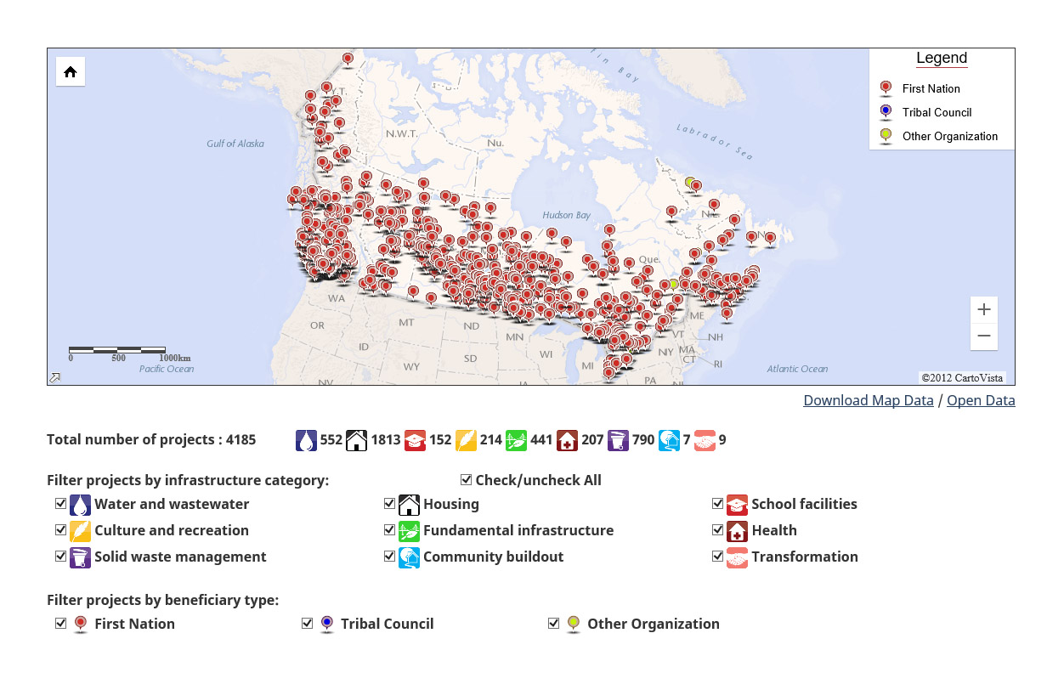
Interactive Map: Investing in First Nations Community Infrastructure
https://geo.sac-isc.gc.ca/ ciir-riim/ciir_riim_en.html
Notes:
Before I get to the specifics of infrastructure spending in BC Region, I want to share this screen grab of an interactive online tool that shows the distribution of community infrastructure spending nationally.
The map shows ongoing and completed infrastructure projects and includes feasibility studies, new construction and renovation, and capacity development projects.
You can google it anytime, or I encourage you to check it out in detail at our Community Infrastructure table. I’d be interested in your feedback – do you find it useful and how could it be improved? Information on this map is updated on a quarterly basis.

Slide 7
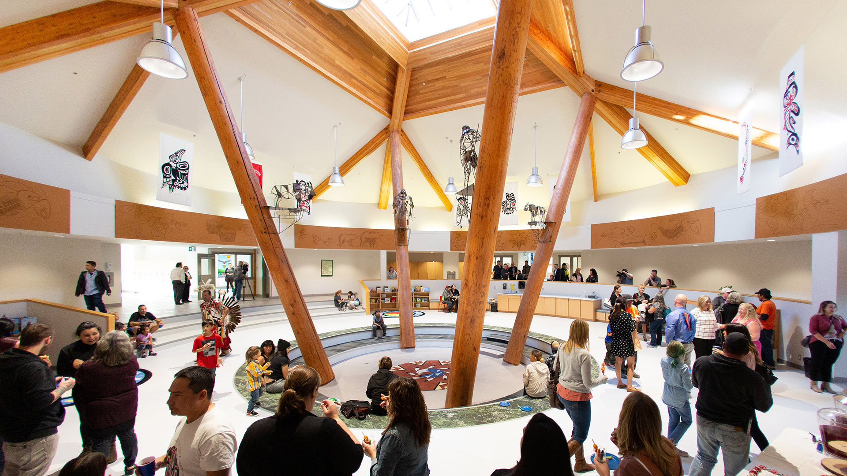
COMMUNITY INFRASTRUCTURE
Westbank sәnsisyustәn School opening, October 2019
Notes:
Infrastructure is about investing in people and communities.
As you’re aware, water and infrastructure continue to be two of the Government’s key priorities, and the benefit to individuals and communities from a new school, home or water system can be life changing.
The Ministers’ mandate letters confirm the Government of Canada’s commitment to eliminate all long-term drinking water advisories on reserve by spring 2021, and to move forward in addressing critical infrastructure needs including housing, high-speed internet, and schools in First Nations communities by 2030.

Slide 8
COMMUNITY INFRASTRUCTURE
BUDGET
$229.7 million (22% of BC Region budget)
37%
Water and Wastewater (capital and O&M)
16%
Housing (capital)
47%
Other Community Infrastructure (capital and O&M)
Data as of January 3, 2020
Notes:
This year’s current total budget for Community Infrastructure is $229.7 million.
You can see here the breakdown of the main investment areas in the program:
Water and Wastewater, including capital and O&M funding
Housing, and
Other Community Infrastructure, such as schools, energy, connectivity, fire protection, roads and bridges, including capital and O&M funding, and mitigation of contaminated sites.
Operation and Maintenance to maintain infrastructure assets is the only part of infrastructure that is currently included in 10- Year Grants.

Slide 9
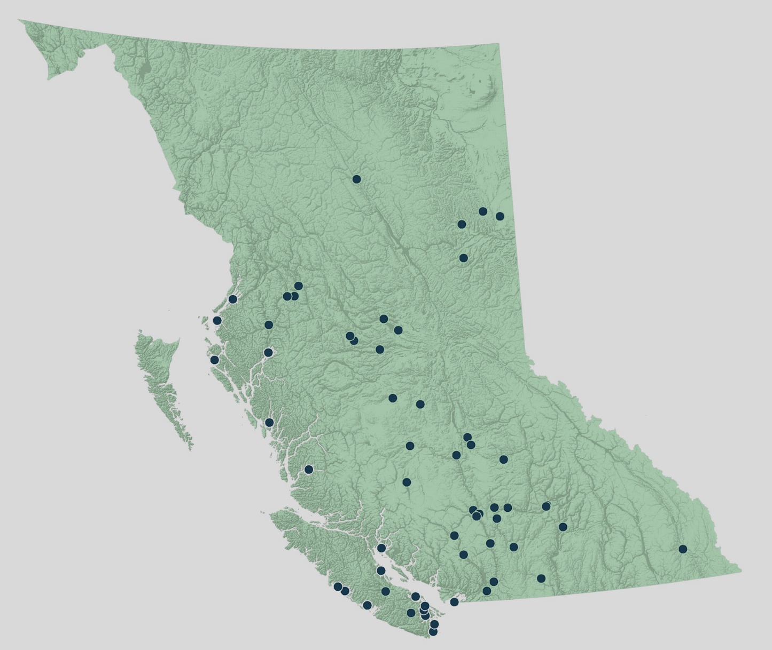
WATER AND WASTEWATER
COMMUNITY INFRASTRUCTURE
Map of the 59 communities that received water or wastewater funding in 2019-20
Data as of January 3, 2020
Notes:
The capital budget to support water and wastewater systems this year is $85.6 million.
To date, $72 million has been distributed across the province to support 66 capital projects in 59 First Nations.
It also supports Operations and Maintenance and for other initiatives like Operator Wage Enhancement, the Circuit Rider Training Program, and Safe Water Operation Program for the 290 water systems that the Department funds.
Investments this year reflect the Government’s commitment to eliminate, by 2021, all long-term drinking water advisories affecting on-reserve public systems.
In 2019, one long-term drinking water advisory was lifted in BC, following the commissioning of the Stellat’en First Nation’s new water treatment plant at their Stellaquo Community Water System.
Three remaining long-term drinking water advisories are expected to be lifted in 2020 and the last one is expected to be lifted in 2021.
We fully appreciate that there are still water and wastewater related needs that need to be addressed and have made such major investments this past year in water and wastewater as highlighted in this map.

Slide 10
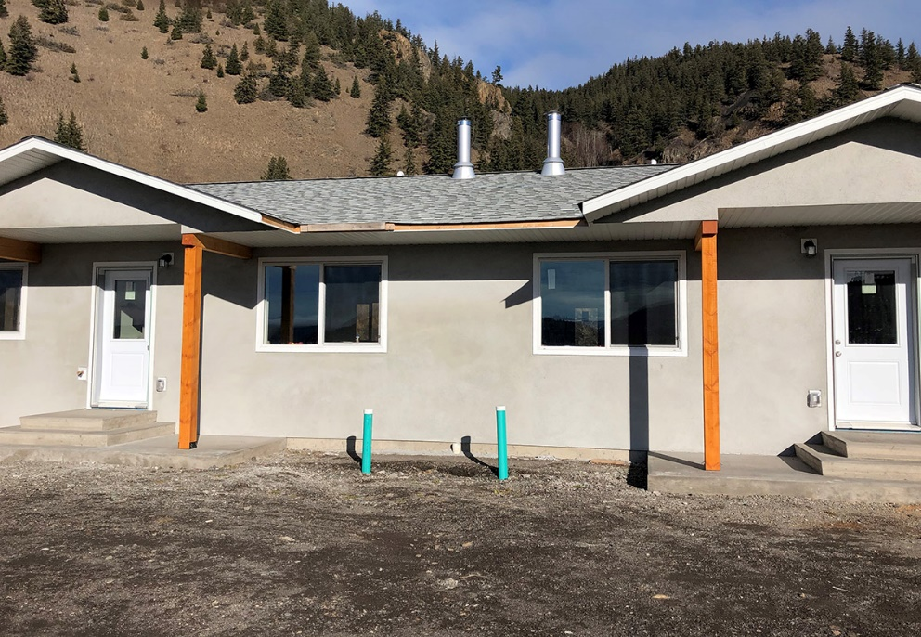
HOUSING – HIGHLIGHTS
COMMUNITY INFRASTRUCTURE
Stswecem’c Xgat’tem – Multiplex housing
Notes:
Our regional housing infrastructure budget (including Grants and Block) this year totals $37.4 million. This funding supports the development of policy, renovations and new construction through the regional housing support program.
To date, we have supported 117 projects in 70 communities and spent $28 million.
For example:
The Stswecem’c Xgat’tem (pronounced - St-Wet-lem Hight-lem) First Nation (pictured) was funded $932,000 for a multi-unit housing project to support the housing needs of their community.

Slide 11
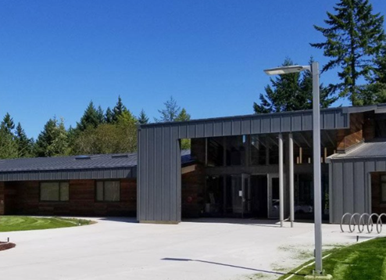
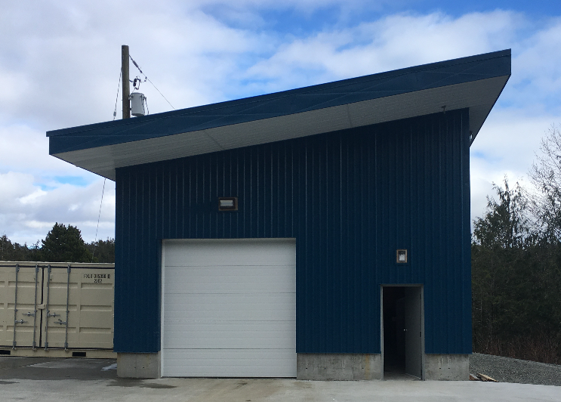
OTHER INFRASTRUCTURE – HIGHLIGHTS
COMMUNITY INFRASTRUCTURE
Snuneymuxw Qwam Qwum Stuwixwulh Elementary School
Kitasoo Recycling Building
Notes:
Lastly, 47 per cent or $106.7 million of Community Infrastructure budget is used to fund other infrastructure projects such as:
Schools;
roads and bridges and other fundamental community infrastructure such as fire protection, community buildings, energy, connectivity, and planning;
waste management; and,
mitigation of contaminated sites.
BC Region is supporting:
77 infrastructure projects such as structural mitigation, fire protection, roads and bridges in 55 communities and other First Nation organizations;
15 waste management projects in 31 First Nations (some initiatives benefit more than one community at a time);
For example, through the BC First Nation Zero Waste Program, Kitasoo First Nation worked to improve their solid waste management system. An upgraded waste management facility was constructed, including this recycling building used to sort and store recyclable materials prior to shipping to a regional district facility for further processing.
Nine (9) school projects in 11 communities;
Sununeymuxw First Nation and the Province of BC celebrated the opening of Qwam Qwum Stuwixwulh Elementary School. ISC contributed $10.6 million in 2018-2019 towards the school which replaced the old one which was overcrowded.
In 2019-2020 Fiscal year to-date, the Contaminated Sites program has funded six (6) remediation/risk management projects.
By end of 2019-2020 Fiscal year, we’re expected to fund an additional 8 remediation/risk management and two (2) assessment projects.
Now moving on to Lands and Economic Development…

Slide 12
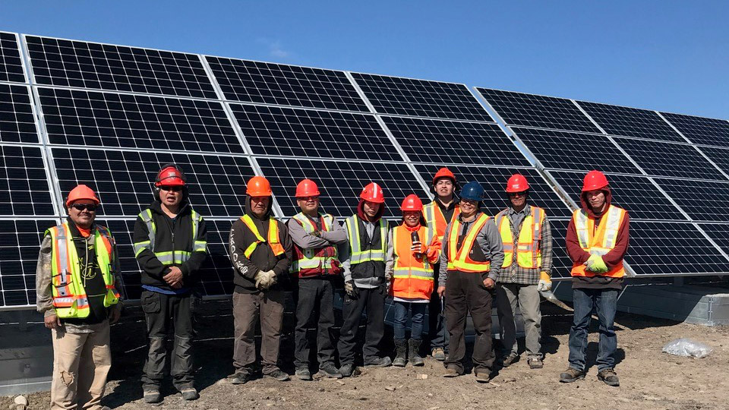
LANDS AND ECONOMIC DEVELOPMENT
Tŝilhqot'in Solar Farm
Notes:
Lands and Economic Development helps support the sustainable development of First Nations lands, resources and economies.
Our staff provides land and environmental management services to First Nations operating under the Indian Act; we also support First Nations in the transition to administering lands management under their own land code as part of the First Nations Land Management Regime.
As a result of increased interest by many First Nations in adding to the reserve land base as well as legal obligations, our staff has increased this year’s targets to achieve up to 15 region-level sign-offs for Additions to Reserve. And we hope to benefit from recently passed legislative changes to simplify the process.
We help support economic development through the process to designate reserve land for commercial use and by administering the Department’s economic development funding programs.
PHOTO CONTEXT: Pictured here is the Tŝilhqot'in Solar Farm that was funded through the Community Opportunity Readiness Program for commercial infrastructure in 2017-2018 and 2018-2019.

Slide 13
LANDS AND ECONOMIC DEVELOPMENT
BUDGET
$32.0 million (3% of BC Region budget)
33%
Economic Development
67%
Lands management
Data as of January 3, 2020
Notes:
This year’s total budget for Lands and Economic Development is $32.0 million.
The $9.3 million decrease from last year’s LED budget of $41.3 million is attributed to several factors, including the end of the $5 million West Coast Energy fund (SPI) that ended after 5 years in March 2019 and fewer Community Opportunity Readiness Projects from BC being funded nationally. Budget 2019 included $15.8 million across Canada to support CORP economic development projects which is only now becoming available. BC Region expects to see more CORP projects funded in the next few months.
Funding is allocated to regional programs that support economic development projects as well as community capacity building in land and environmental management and economic development.
It includes working in collaboration with Cando and NALMA to support BC First Nations lands managers and economic development officer to gather in Vancouver for the Links to Learning technical training forum. Over 150 delegates attended last month’s Links to Learning.

Slide 14
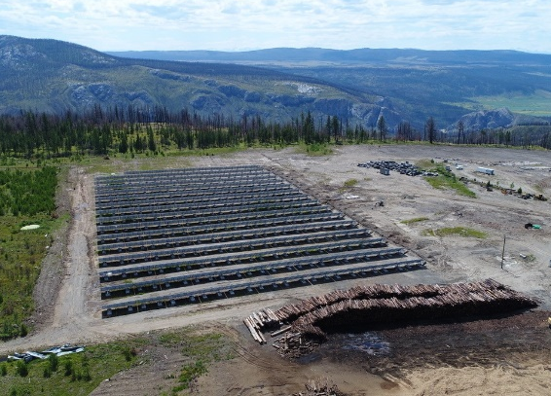
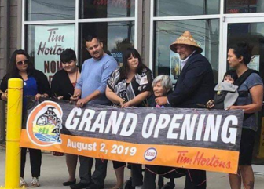
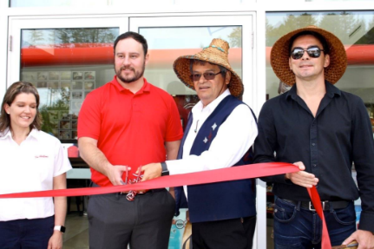
LANDS AND ECONOMIC DEVELOPMENT – HIGHLIGHTS
Tŝilhqot'in Solar Farm
The Tŝilhqot'in Solar Farm opened this year
Leq’a:mel First Nation
T’Sou-ke First Nation
Installation of site services and paving to allow for mixed commercial use for both T’Sou-ke First Nation and Leq’a:mel First Nation.
Notes:
We continue to work with First Nations to promote the development of economic opportunities and would like to highlight the following First Nations and their projects:
With support from Community Opportunity Readiness Program (CORP) funding, Tŝilhqot'in Solar Farm opened this year. The solar farm is a clean energy project that will not only provide energy to local homes, but also generate revenue for the community.
CORP funding also helped both T’sou-ke First Nation and Leq’a:mel First Nation to create commercial leasing opportunities by supporting the installation of utilities and develop the sites of previously unused parcels of reserve land. As a result, both Nations celebrated the openings of a gas station and Tim Hortons last year.

Slide 15
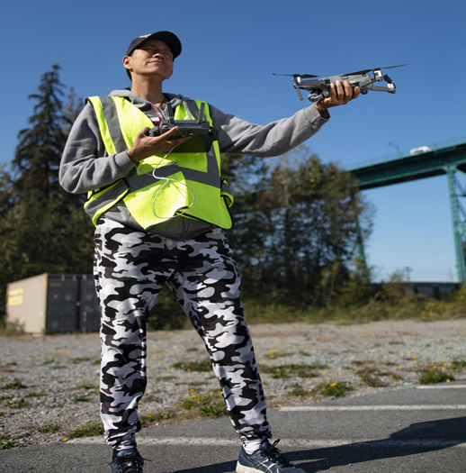
LANDS AND ECONOMIC DEVELOPMENT – HIGHLIGHTS
Drone Stewardship Training Program via First Nations Technology Council
Land Use Planning Handbook
Notes:
For reserve land management and environmental stewardship, BC Region provides project funding to support capacity building initiatives.
Over the past several years, we have seen increased growth in requests for reserve land designation votes and commercial leasing as well as additions to reserve for economic and community development needs.
Through its capacity funding, BC Region has funded drone stewardship training to assist First Nations with monitoring their land bases and the release of a land use planning handbook at Links to Learning.

Slide 16
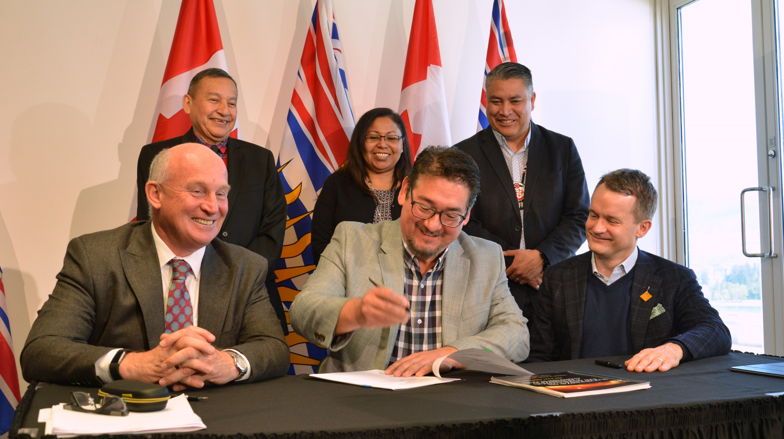
EMERGENCY MANAGEMENT
Signing of Tripartite Memorandum of Understanding on Emergency Management
Notes:
2019 brought on many changes with regard to emergency management to respond to after-action reports and lessons learned from 2017 and 2018.
The First Nations Leadership Council, ISC and the Province entered into a Tripartite Memorandum of Understanding on Emergency Management Services which was signed in April 2019. The MOU represents a commitment to collaborate on emergency management, work collectively to enhance capacity, and ensure that First Nations are recognized as full partners in both the governance and operations of emergency management.
A Tripartite Working Group, and a technical working group made up of emergency management champions from First Nations throughout BC, will support implementation of the MOU and ensure that First Nations’ voices remain at the forefront of service improvements.
There is more work to be done to ensure that the emergency management system reflects the diversity of First Nations, geography, risks and hazards, and capabilities and brings in more players.

Slide 17
EMERGENCY MANAGEMENT
BUDGET
$14.8 million (1% of BC Region budget)
6%
Capacity
13%
Non-Structural Mitigation and Preparedness
32%
Response and Recovery
15%
FireSmart
34%
Service Agreements
Data as of January 3, 2020
Notes:
The total expenditures this fiscal for emergency management is $14.8 million.
Budget 2019 - provided an additional $5.025 million in Emergency Management investment to BC First Nations. This investment will rise to $6.2 million in year five.
For the current fiscal year, this investment means that:
90 non-structural mitigation and preparedness projects will reach over 100 First Nations in BC and 34 First Nations will receive support for on-reserve fuel mitigation and wildfire firefighter training
New Emergency Preparedness Coordinators are working with 59 First Nations in BC, with more to come in 2020.
Every First Nation has been provided with a laptop dedicated to emergency management through Professional and Institutional Development (P&ID) funding, so emergency plans, contact lists, etc., can be kept in a consistent place; avoiding the need to use personal devises in the case of an emergency.
$4.98 million service agreements with Emergency Management BC and BC Wildfire Service ensure that BC First Nations receive emergency management and wildfire suppression services to comparable to those available to all British Columbians.
Response and recovery are needs based depending on emergency events, and these costs can therefore vary from year to year.
As of January 3, 2020, ISC invested $4.8 million in response and recovery, and an additional $2.8 million has been approved since that date.
This is down from $18.6 million in the previous year thanks to fewer emergencies this fiscal year.
Since the introduction of Building Back Better, ISC is now able to support efforts to address an imminent risk on reserve prior to an emergency event occurring.
We know recovery after an emergency is a lengthy process and we are committed to continuing to work with communities that have been impacted in recent years.

Slide 18
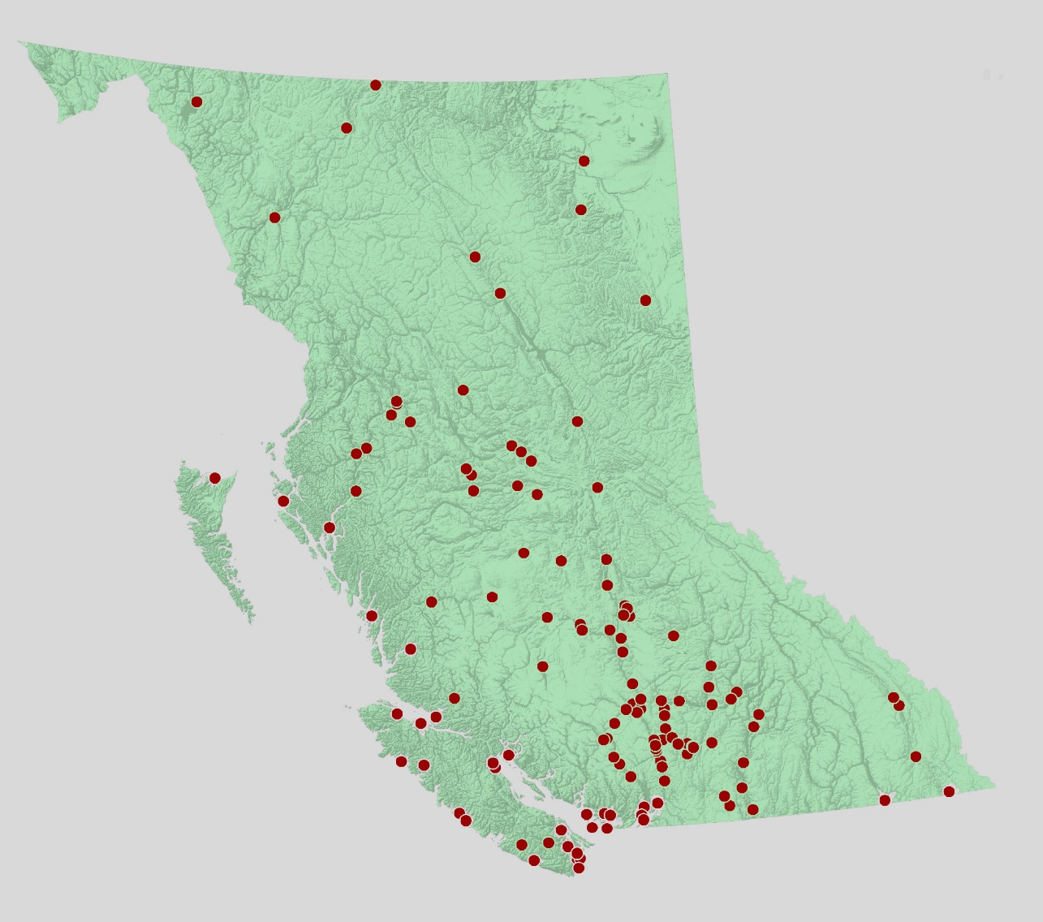
EMERGENCY MANAGEMENT
Map of the 132 communities that accessed Emergency Management Assistance Program funding in 2019-20
Data as of January 3, 2020
Notes:
As you can see in this map, the red dots indicate the communities that have received any kind of emergency management funding in 2019.
In total, 132 First Nations accessed Emergency Management Assistance Program funding through one or more streams in 2019.

Slide 19
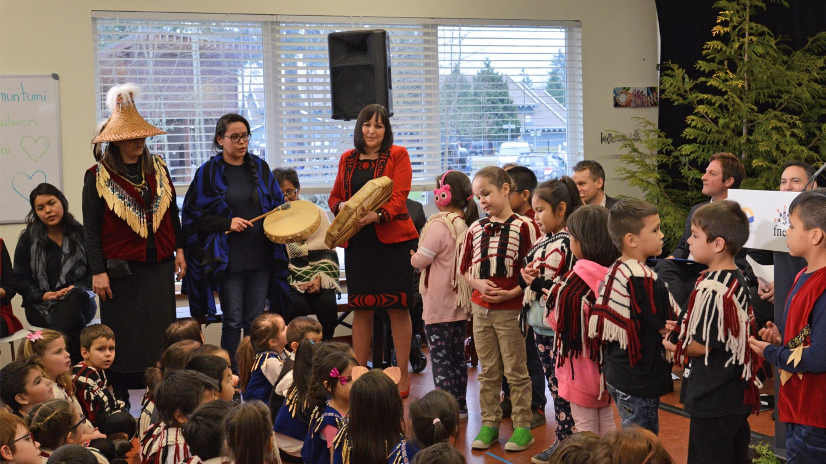
EDUCATION
BC Tripartite Education Agreement Celebration
Notes:
Investment in First Nations Education continues to be a priority for First Nations and the Department, with over one third of the regional budget to supporting the elementary, secondary and post-secondary education of First Nations learners.
Most education-related funding flows directly to First Nations or to the First Nations Education Steering Committee (FNESC).
Exceptions to this include approximately $30 million to the Ministry of Education for elementary/secondary provincial tuition and $1.8 million that flows to post-secondary institutes through the proposal driven Post-Secondary Partnerships Program.
Budget 2019 resulted in continued increases in funding for post-secondary education for five (5) years, translating into $7.85 million per year for BC.

Slide 20
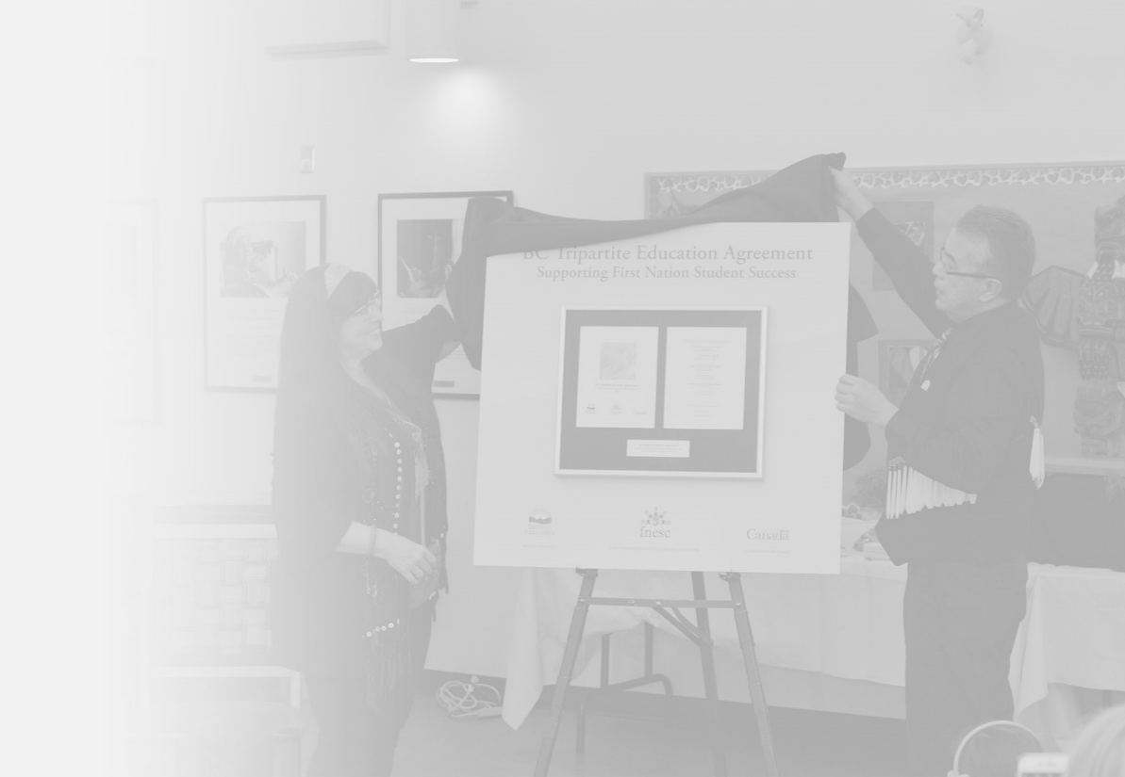
EDUCATION
BUDGET
$357.4 million (33% of BC Region budget)
Data as of January 3, 2020
Notes:
This year’s total budget for Education is $357.4 million.
Of this total budget, $288 million is related to the Elementary and Secondary Education Program which is governed by the BC Tripartite Education Agreement.
This year’s education budget has gone up $20 million from last year. The increase largely occurred within the Elementary and Secondary Education Program, under the auspices of BCTEA, and can be attributed to a number of factors:
$3.8 million contributed by Canada to the transportation of First Nations students living on reserve attending public schools
An increase in the First Nations Student Rate for students living on reserve attending public schools
Expansion of Kindergarten (Age 4) from half to full day.
As of September 2019, First Nations operated schools that offer full-time Kindergarten for 4-year olds (K4) may now claim 1.0 Full Time Equivalent (FTE) on the Nominal Roll resulting in increased funding. This funding increase for 2019-2020 would not be seen until adjustments are made 2020-2021 based on the finalized 2019-2020 Nominal Roll.

Slide 21
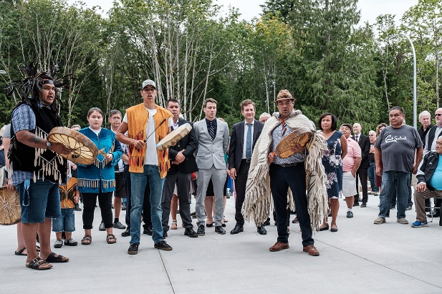
EDUCATION – HIGHLIGHTS
Photo Credit Don Craig BC Government
Funding for connectivity in First Nation schools
Opening of the new Qwam Qwum Stuwixwulh Community School
Notes:
Highlights of funding include:
Funding for connectivity in First Nation schools
Through the negotiation efforts of FNESC, Canada has been ahead of the current mandate in BC by supporting connectivity upgrades for First Nations schools. In 2019-2020, $2.4 million is committed to support ongoing connectivity maintenance.
Since 2017-2018, Canada has provided $5.4 million to FNESC to provide new computers as well as the installation and project management for connectivity upgrades for 90 First Nations, including 116 school sites. All upgrades have been completed.

Slide 22
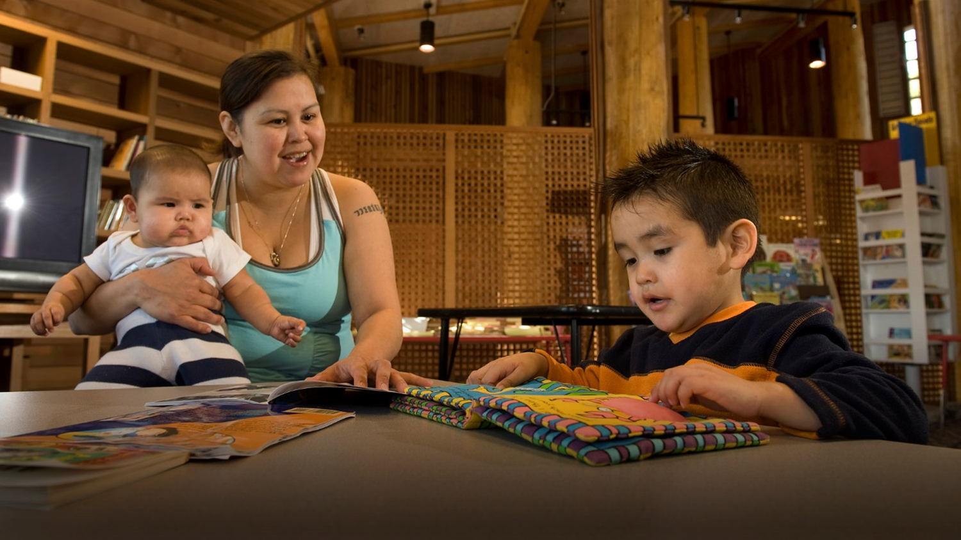
CHILD AND FAMILY SERVICES
Notes:
On January 1, 2020, Bill C-92, an Act respecting First Nations, Inuit and Métis children, youth and families, came into force.
This new law, co-developed with partners, affirms the rights of Indigenous peoples to determine their laws, policies and practices in relation to Indigenous child and family services and sets out basic principles that must be followed by every person providing services to Indigenous children.
As Joanne outlined yesterday, this marks a new chapter in Canada's relationship with Indigenous peoples. It is designed to improve the health and well-being of Indigenous children and youth now, and for generations to come.
The new law emphasizes the need for the system to shift from apprehension to prevention, with priority given to services that promote preventive care to support families. It further supports Indigenous children in care by:
helping them to stay with their family and community; helping children currently in care to return to their family;
ensuring they stay connected with their language, culture and community; and
reducing the number of children separated from their families only because of financial, health or housing challenges.
As Minister Miller said in his statement, “change will not come overnight.“
Certainly there was passionate conversation at yesterday’s plenary session on Implementing this new law.

Slide 23
CHILD AND FAMILY SERVICES
BUDGET
$160.7 million (15% of BC Region budget)
Data as of January 3, 2020
Notes:
This is the Directorate’s first full year, and it has a budget of $160.7 million.
Since April 1, 2019, under the new Directorate the Department has approved:
$114.275 million to our 20 Aboriginal Child and Family Services Agencies for Operations/Prevention services and maintenance costs up from $71 million in 2018-2019;
$29.1 million to the Ministry for Child and Family Development for services and maintenance costs to the 82 unaffiliated First Nations and those partially delegated agencies;
$14.01 million to the 82 unaffiliated First Nations for Community Well-being and Jurisdiction Initiatives;
$1.165 million to support CFS jurisdiction discussions; and
$2.9 million to support HQ funded initiatives (MSR commitment from 2017)
As mentioned earlier on in my presentation, for the purpose of demonstrating how the BC Region budget is allocated, we’ve separated out Jordan’s Principle from Child and Family Services – as monies are set aside specifically for Jordan’s Principle, we wanted to show the budget dollars that go to specifically supporting CFS.

Slide 24
JORDAN’S PRINCIPLE
CHILD AND FAMILY SERVICES
600+ children received psycho-educational assessments
300+ children received speech and language therapy
550+ children received tutoring and education supports
400+ children received mental health services
450+ children received occupational and physiotherapy services
150+ children received medical devices
250+ cases of medical travel coverage
Data as of January 3, 2020
Notes:
As you are likely aware, last February, the responsibility for the administration of Jordan’s Principle was transferred from the First Nations Health Authority to ISC BC Region.
The decision to transfer Jordan’s Principle to ISC was a mutual decision made by ISC and FNHA in light of a May 2017 Canadian Human Rights Tribal order which expanded the of scope for Jordan’s Principle to cover all government funded services for all First Nations children (on and off reserve).
Originally, much of the focus of Jordan’s Principle was on health related requests, but the May ruling broadened the scope of Jordan’s Principle to include social and educational requests, which the Health Authority is not responsible for.
It was agreed that ISC would be better positioned to implement the full scope of Jordan’s Principle. Also, there was agreement that Canada should not be delegating its legal obligation for Jordan’s Principle.
That being said, from March 2018 to December 2019, approximately 5,000 requests totaling about $38.7 million were approved in BC Region.
As you can see on the slide, thousands of children have received vital health, education and social supports.
BC Region has recently received approximately $5.4 million per year for three years to fund enhanced service coordination. This funding will support approximately 35-40 service coordinator positions across BC. Community-based service coordinators serve as a knowledgeable resource to help families
navigate existing federal and provincial/territorial health, social, and educational programs and services;
contact Indigenous Services Canada (ISC) on behalf of children and their families; and
access health, education and social supports through Jordan’s Principle.
ISC will continue to work with First Nation organizations and communities to develop a regional model for the delivery of service coordination. I encourage you to attend the Jordan’s Principle Service Coordination breakout session later today.

Slide 25
INCOME SUPPORT PROGRAMS
Notes:
Under Income Support Programs, ISC funds First Nations and First Nations organizations to administer benefits and services to individuals and families living on Reserve.

Slide 26
INCOME SUPPORT PROGRAMS
BUDGET
$138.6 million (13% of BC Region budget)
86%
Income Support
11%
Assisted Living
4%
Family Violence Prevention Program
Data as of January 3, 2020
Notes:
This year’s total budget for Income Supports is $138.6 million, similar to last year’s budget.
Budget 2018 allocated $78.4 million nationally for fiscal years 2019-2020 and 2020-2021 to support the continuation of the Income Assistance Pre-Employment Supports initiative across Canada. Funding provides case management and client supports to assist individuals on Income Assistance transition to employment and education.
Through Budget 2018, BC Region allocated $6.2 million in fiscal year 2019-2020 to support eight (8) regional hubs (operated by recipients) delivering case management and pre-employment supports and services to 46 First Nation communities.
Budget 2018 also committed $8.5 million over two (2) years “to work with First Nations to make the IA program more responsive to the needs of individuals and families on reserve and to identify supports required to help individuals better transition from income assistance to employment and education.
The First Nations-led engagement sessions held nationally have been completed with a final report to be published before the end of the fiscal year (March 31, 2020).
And in February, a shelter for vulnerable women and children will open along the Highway of Tears. It is rare that culturally appropriate services are available to Indigenous women in crisis, and this unique partnership between Carrier Sekani Family Service and the Lake Babine Nation, will also provide wrap around supports to the children. This year BC Region will provide $280,000 for start up costs. Moving forward the region will fund ongoing operations.

Slide 27
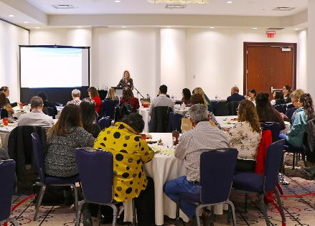
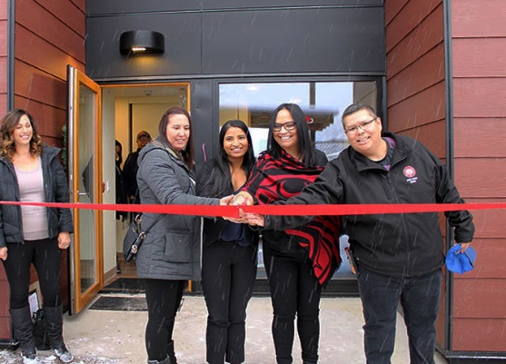
INCOME SUPPORT PROGRAMS – HIGHLIGHTS
Workshops for Band Social Development Workers
Opening of the family violence safe house shelter in Lake Babine
Notes:
Additional highlights of Social Programs include:
Increase in Special Needs Allowance by 18%:
The Allowance is intended to provide financial assistance on a one-time, exceptional basis to eligible Income Assistance recipients who face emergency needs.
We need to work with you to ensure this is getting to individuals in need given the regional budget has not increased since 2009.
Band Social Development Workers (BSDW) training :
This past year, training sessions were held in Prince George, Kamloops, Parksville and Richmond –sessions included technical information on income assistance, assisted living, pre-employment supports, reporting and program review and a much-requested workshop on Dealing with Difficult People.

Slide 28
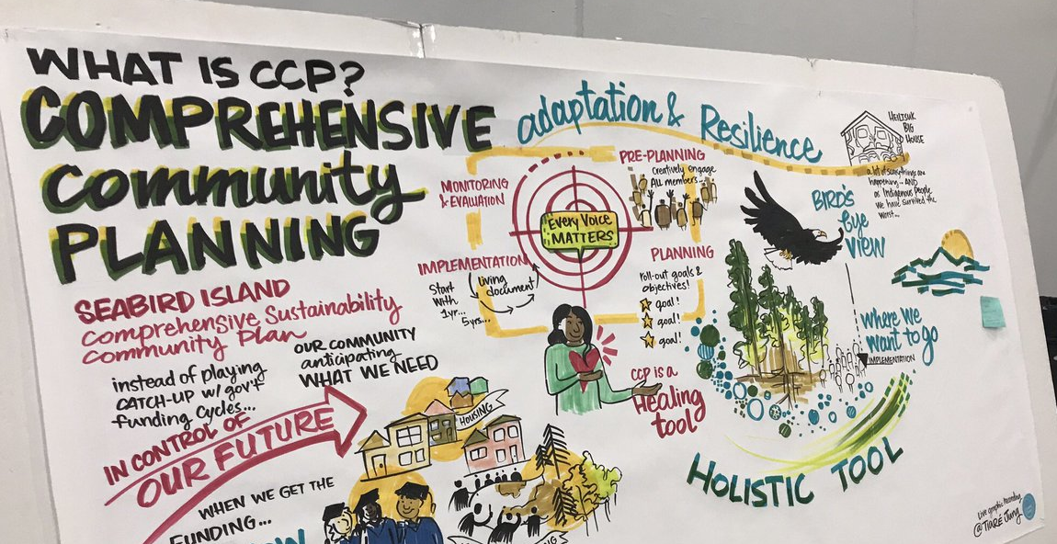
GOVERNANCE AND INDIVIDUAL AFFAIRS
Graphic recording from 2019 BC Region CCP Workshop
Notes:
Governance and Individual Affairs supports:
First Nations governance and capacity development;
Comprehensive Community Planning and community-to-community mentorship;
Indian registration, including Status Card application intake and recording life events such as births, deaths, and marriages; and,
Individual affairs activity such as, Wills and Estate planning, Estate administration.

Slide 29
GOVERNANCE AND INDIVIDUAL AFFAIRS
BUDGET
$92.6 million (9% of BC Region budget)
94%
First Nations Administration
5%
Consultation & Capacity Initiatives
1%
Individual Affairs & Comprehensive Community Planning
Data as of January 3, 2020
Notes:
This year’s total budget for Governance and Individual Affairs directorate is $92.6 million
Key components of this Directorate’s approach have been to target funding to build key foundation capacity within a First Nation and to support Comprehensive Community Planning. CCP is a foundational building block for sustainable prosperous communities through direct correlation to these FNs pursuing land use planning, economic development plans, and environmental management plans.
As of January 1, 2020, over 170 First Nations have participated in a CCP process, and 127 First Nations have completed plans. Of interest, last year 166 FNs participated, 112 completed plans)
Additional Key highlights for this Directorate include:
Secure Certificate of Indian Status - Photo app
Last summer, the Department rolled out the SCIS photo app to the public. The app allows all registered applicants to submit their photos at no cost. All SCIS cards now feature a machine-readable zone, enabling a faster, smoother border crossing experience for clients. The app is free to download and is available from the Apple Store and Google Play.
In 2019, Secure Certificate of Indian Status outreach events were held in Prince George, Campbell River, and Port Alberni resulting in 636 applications made using the new photo app.

Slide 30
NEW FISCAL RELATIONSHIP
34 Ineligible (39%)
BC First Nations Eligible for 10-Year Grant – April1,2019
All have a Financial Administration Law (FAL) or Bylaw (FAB) and meet the financial performance criteria.
Existing grant recipients are primarily based in southern BC with a sprinkling of communities spread out over the entire province
89 Expression of Interests
52 Eligible (61%)
COMMUNITY SIZE
46 Recipients
small
64%
36%
large
LOCATION
isolated
11%
4%
28%
57%
urban
Data as of: Sep 2019
Community size: Small = population lower than 1000; Large = population of 1000 or more
Location: Isolated = no year-round road access to a service centre; Remote = over 350 km from the nearest service centre with year-round road access; Rural = between 50 and 350 km from the nearest service centre with year-round road access; Urban = within 50 km from the nearest service centre with year-round road access
Notes:
Yesterday’s session on the NFR provided an update on the important work of the AFN-ISC Joint Advisory Committee on Fiscal Relations and towards a New Fiscal Relationship – including the foundation elements of sufficient and sustained funding for communities; and a renewed economic and fiscal relationship that ensures nations have the revenue generation and fiscal capacity to govern effectively and to provide programs and services to those for whom they are responsible.
Building on the successful launch of the 10-Year Grants for BC First Nations, there are THREE initiatives underway:
Supporting First Nations WITH a Grant:
The Department is working collaboratively with our partners, FMB, AFOA-BC, and FNPSSS to support the 46 BC First Nations that entered into a 10-Year Grant.
Towards that goal, a successful forum took place in October bringing together representatives from 40 of the 46 First Nations. BC Region continues to work with First Nations with 10-Year Grants and our partners to determine what support and information is required to successfully implement this new, more flexible funding approach for First Nations to design and deliver programs to better suit the needs and priorities of their community.
2) New 10-Year Grant Recipients for April 1, 2020:
34 expressions of interest in a New Fiscal Relationship 10-Year Grant for April 1, 2020 were received from BC First Nations.
3) First Nations working towards 10-Year Grant Eligibility:
First Nations working to meet the eligibility requirements for the 10-Year Grant are encouraged to continue to work with FMB. All First Nations applying for the 10-Year Grant have access to FMB-developed tools, as well as advice and support at no cost from the FMB in working towards meeting eligibility criteria.
All First Nations interested in developing their governance capacity can submit a project proposal through the Professional and Institutional Development Program. All First Nations are eligible for project-based funding under this Program, regardless of their interest in the 10-Year Grant.

Slide 31
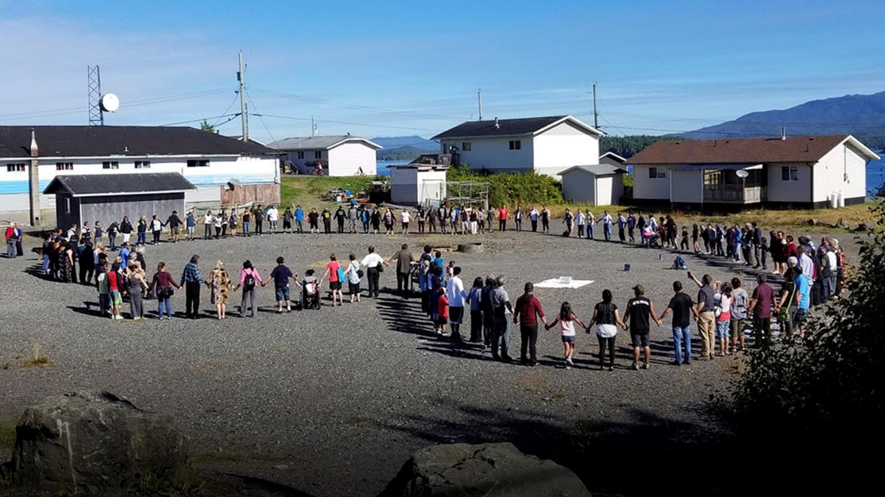
IN CLOSING…
Gitxaala community gathering | Photo credit: Colin Angus
Notes:
In closing
I hope that was helpful in the understanding of BC Region’s investments this year and how they compare to last year.
In this presentation, we attempted to group expenditures in meaningful ways. You have also been provided with a Dashboard that drills down and provides more detailed analysis. Of course, if you have questions, you are welcome to ask me or any of our directors.
------------------------------------------
Although not a budget item, I do want to take a minute to highlight the work that has been done this year on Service Excellence.
Service Excellence needs to remain at the heart of Indigenous Services Canada. We’ve undertaken several building improvements to make our building easier to navigate and more inviting to visitors.
However, the changes to the physical structure are meaningful only if we provide service excellence to you and your members. Our internal service excellence working group continues to examine how the Department can provide efficient, seamless and effective services to First Nations.
Every ISC staff member must now complete manadatory Cultural safety and humility training, which provides them with tools to help us examine our own cultural identities and biases; and
We continue to use our “Service ABCs”, which are a set of standardized approaches, to help ensure everyone receives the same level of service when we respond to enquiries and proposals, It has been shared across the Department for new staff orientation sessions.
Much work still remains though and that’s why we ask that you continue to provide feedback on the service we provide.
I would like to now open the floor to any questions you may have for me or my directors.

